Slide 1

Predicting Online Shopper’s Intention
-Vaishnavi Mane

Slide 2


Slide 3



Slide 4

Affects Revenue and Growth Prospects.

Slide 5

Business Problem
Understand customer behaviour to optimize website design and marketing strategies.
Predicting revenue making sessions helps:
to personalize recommendation
marketing efforts
increase sales and revenue.

Slide 6
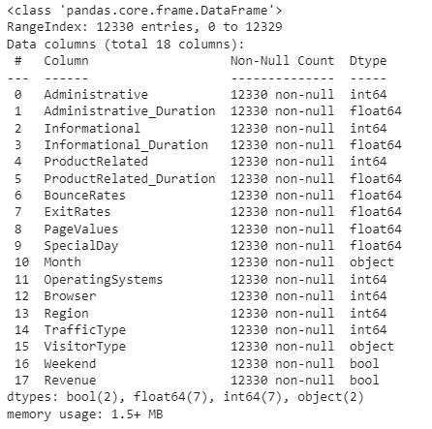
Data:

Slide 7

Assumptions:
Model is trained on Historical data to make prediction for the future.
Accuracy may be affected by changes in user behaviour or external factors.
Assumed that factors are sufficient to predict.

Slide 8

Implementation:
Decision Tree Classifier
Support Vector Machine
Logistic Regression
Random Forest Classifier

Slide 9
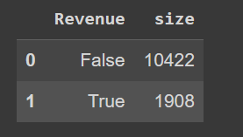
Challenges:
Class Imbalance:
SMOTE for oversampling from imblearn library for class imbalance with Cross validation to avoid overfitting.

Slide 10
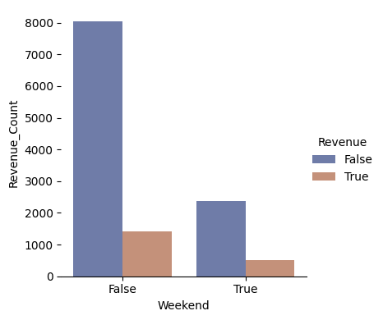
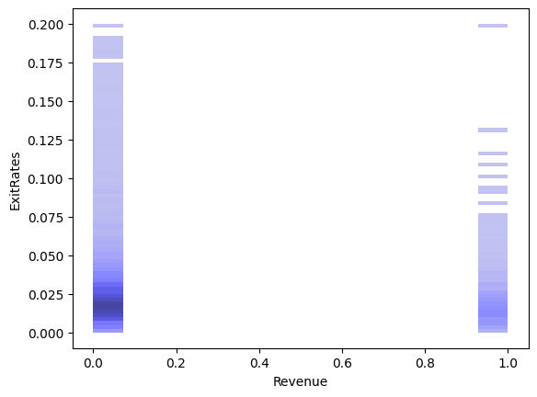
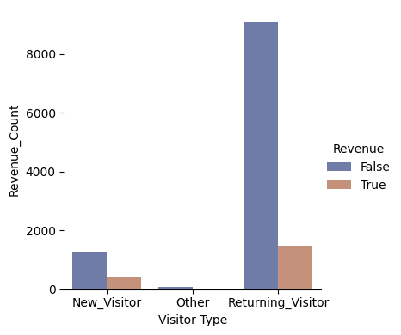
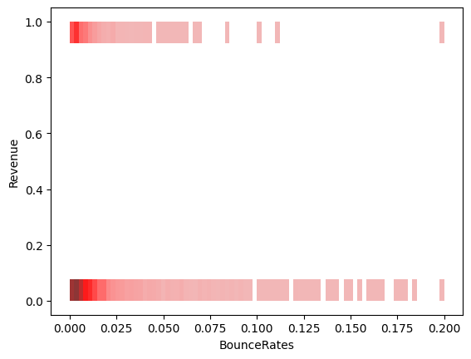
Challenges:
Complex features:

Slide 11
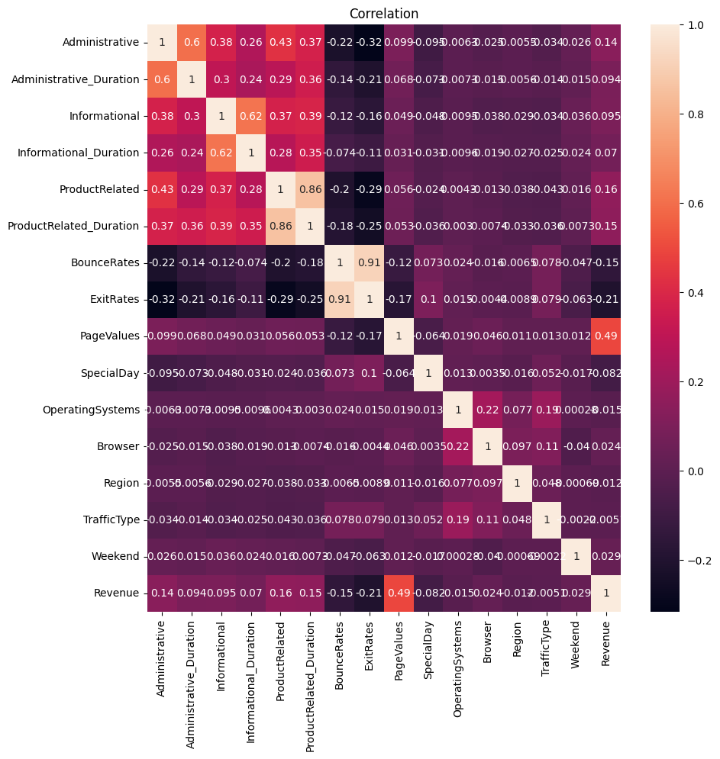
Challenges:
Correlation:

Slide 12

Conclusion:
Random Forest Classifier(89.69%) Best Model for predicting Online Shoppers Intention.
This Photo by Unknown Author is licensed under CC BY-NC

